Slide 1
Résumés & Cover Letters
EPSY 220
TA: Matt King

Slide 2
Purposes of a Résumé
First impression on potential employers
Example of your organizational and written skills
Describes, documents, and quantifies experiences
Demonstrates established goals to a potential employer
Can lead to an interview
Outline for interview questions
Notes:
It’s important that audience members understand that resumes do not get you a job; rather, resumes get you an interview offer for you to discuss with an employer why you’re an exceptional fit for a position/company.

Slide 3
Résumé
What is Résumé?
Assessment of skills in terms of specific job objectives
A memory-aid in interviews
An Aid for filling out applications
A tool for marketing yourself and your skills… personal “advertising”

Slide 4
Résumé vs. CV
Resume
CV
1 Page
Bare bones information
Used widely!
Customized
Loooooooonger
Tons of details (publications, awards, affiliations)
Used in academia
Used internationally Not so customized
Notes:
Curriculum Vitæ, which means course of life in Latin

Slide 5
3 Types of Résumé
1) Chronological
Ordered by dates of employment/experience
Provides work history in order
Highlights progress toward a career
Demonstrates a stable or continuous work history
Emphasizes most recent job, even if it is not the most impressive
As a result, does NOT highlight transferable skills

Slide 6
3 Types of Résumé
2) Functional
Organized around specific skills
Emphasizes strengths directly related to job
Allows those who are entering or changing careers to demonstrate applicability of skills gathered elsewhere
Downplays gaps in employment history and unrelated (or lack of) employment experience

Slide 7
3 Types of Résumé
3) Chrono-Functional
A blend of chronological/functional
Very common; has the strengths of both formats
Room for emphasis on extracurricular & college activities
Difficult to write!!! (Difficult to keep formatting consistent w/in sections)

Slide 8
Frequently Asked Questions:
1. HOW LONG SHOULD MY Résumé BE?
One page!!! Readability and brevity are the major points
Yes, for real, 1 page
It’s an introduction to the best & most relevant that you have to offer. Use your cover-letter to flesh yourself out!

Slide 9
2. SHOULD I INCLUDE A “JOB OBJECTIVE”?
This is much less common now that most people send cover letters with their résumé
If you do include a job objective, it goes just below your name & contact info (e.g., it is the second block of information on your résumé)
Be sure to write different objectives for different jobs you’re applying for (i.e., don’t give employers a “universal” objective)

Slide 10
3. SHOULD I LIST PERSONAL INTERESTS?
My advice is NO
Only mention personal interests that relate to your professional goals or demonstrate an applicable, unique, or prized skill
Ex.’s:
Relevant volunteer work
Leadership positions (e.g., head of an RSO)
Academic, athletic, or service awards at the university/college, city, county, state, region, or national level

Slide 11
4. SHOULD I LIST REFERENCES?
NOOOOOOOO!
Don’t even write “References Furnished Upon Request”… of course they are! Writing it is a waste of valuable space!
References are only used for the interview; bring a list of 2-4 (pre-checked) references with you.

Slide 12
General Rules
Check for Errors
Even one error is unacceptable
Is it readable?
How well do you use “white space”?
Is it pretty? (not just in your own eyes)
Have others give you feedback on how it looks

Slide 13
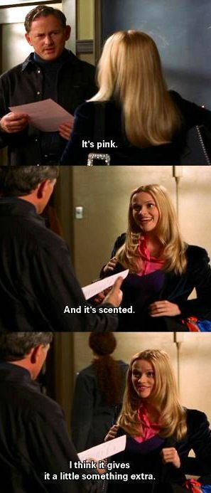
Notes:
https://s-media-cache-ak0.pinimg.com/236x/05/11/df/0511df5b956bd196b66f81ff7eea5f8c.jpg

Slide 14
Constructing a Résumé
BLOCK 1- Personal Information
Name (bold if possible, middle of page)
Address (if still on campus, put a local/present AND permanent address)
Phone number (make sure your voicemail is professional)
E-mail (make sure your e-mail address is professional… sexydood20@gmail.com will NOT impress :-P)

Slide 15
John Doe
309 Green Street ▪ Champaign, IL 61820 ▪ (217)-000-0000 ▪ doej@Illinois.edu

Slide 16
Constructing a Résumé
BLOCK 2- (OPTIONAL) Job Objective
Be specific
Use action oriented words and phrases
Avoid use of words like “I” and “me”
Use only one occupational field per résumé

Slide 17
Constructing a Résumé
BLOCK 3- Education
Must have: School name, location, name of degree, area of degree/major, date received or expected, honors received
For entry jobs, need to have: GPA
If your GPA isn’t awesome, you can list multiple types of GPA (e.g., JR/SR, Science, or Major GPA)
My grad app listed GPA: 3.68, Major GPA: 3.97… see how much smarter that makes me look?

Slide 18
EDUCATION
University of Illinois at Urbana-Champaign Expected graduation May 2017
Bachelor of Science in Business-Administration GPA: 3.35/4.00

Slide 19
Constructing a Résumé
BLOCK 4- Skills
(for Functional Résumé only)
Title: “Relevant Skills”; “Areas of Effectiveness”
Follow the “Rule of 3” or “STAR your stems”
Start with a general, yet applicable descriptor (stem)
List at least 3 specific, STAR-worthy examples of skills that fit the stem
Pick skill stems that fit the job
Be detailed!

Slide 20
Brief Interlude: The STAR Method
Everyone says they’re a leader, a good communicator, a hard-worker, etc. The STAR method is how you prove it!
Ex. of STAR applied to leadership:
1) Situation: describe necessary background info/set the scene for a situation where you were a leader
2) Task: describe the task at hand that required you to be a leader
3) Action: describe exactly what you did that demonstrated leadership
4) Results: describe the results of what you did

Slide 21
Skill Stems Examples
Interpersonal
Organizational
Counseling/Advising
Creative
Communication
Teaching
Supervisory
Administrative
Office/Clerical
Computer
Leadership
Research
Management
Negotiation

Slide 22
Example of Block 4: Skills
Skills
Teaching
7 semesters of collegiate teaching experience, including 8-week, 16-week, and online course sections
Ranked as Excellent (in the top 10% of all instructors) by students
Emphasis on the unique learning needs of first-generation, academically high-risk, and student-athlete populations.
Research
Trained in quantitative, qualitative, and mixed methodologies
Recipient of 2 research grants worth several thousand dollars each
Author of 2 peer-review articles and 2 chapters in edited volumes

Slide 23
Constructing a Résumé
BLOCK 5- Experience
Title: “Relevant Experience”, “Employment History”, “Work Experience”
Includes: Job title, employers, location, dates you worked
Under each entry, describe some of the responsibilities or tasks
List in order from MOST RECENT to LEAST RECENT jobs you’ve held
Don’t lie!

Slide 24
How To Create Strong Bullet-Points ?
Always Start with a Strong Action Word
Ensure bullet-points are in the appropriate tense
Emphasize accomplishments and results/outcome
Quantify accomplishments and tasks
Provide details 5Ws- Who? What? Where? When? Why?
Each experience should have at least 2 bullet points and no periods
Avoid the use of personal pronouns (I, We, Us, Our, etc.)
Focus on Transferable Skills
Notes:
Bullet points are the MAIN and MOST IMPORTANT component in your resume

Slide 25
Bullet-point Example
Weak bullet point examples:
Strong bullet point examples:
WORK EXPERIENCES
University Housing Urbana, IL
Resident Advisor August 2012-Present
Make events and programs.
Work with other staff members daily.
WORK EXPERIENCES
University Housing Urbana, IL
Resident Advisor August 2012 - Present
Organize cultural and diversity-related workshops and events for over 50 residents
Collaborate with 20 Resident Advisors and 2 Multicultural Advocates to plan community programs

Slide 26
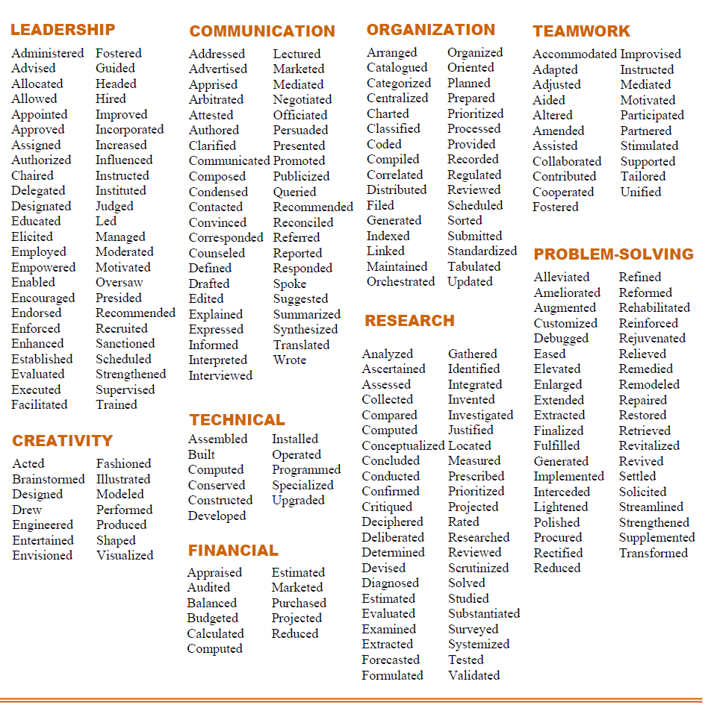
Action
Words
Notes:
Action word handout. Students can pick this up at TCC Resource Center or Online at careercenter.Illinois.edu

Slide 27
Constructing a Résumé
BLOCK 6- Activities/Honors/Awards, or Relevant Courses etc. (Optional)
Can be placed almost anywhere (after education, skills or work history)
Functional: list only title and organization
Chrono/Functional: can be integrated into “Relevant Experience’
Chronological: list by date with most recent first

Slide 28
Important to Remember:
Free of errors; clear, precise, and detailed
Consistent format style within sections:
if you bold, indent, or italicize once, keep doing it in the same pattern for all entries in that section
Use appropriate professional résumé paper (thicker than avg. paper)
One page only*
Use keywords mentioned in the job ad
Make sure it’s READABLE & PRETTY: not folded, faxed, shaded, abbreviated, etc.

Slide 29
In Summary
Dos:
DO NOTs:
Stress your accomplishments
Create detailed bullet-points (5Ws)
Proofread and have it reviewed
Be consistent (font, dates & punctuation)
Check for errors
Exaggerate or lie
Undermine yourself or experiences
Use the same word more than once in a bullet or section
“References available upon request”
High school information
Make statements negative (i.e. “Got supervisor fired”)

Slide 30
Cover Letter
One page only
Make your cover letter matches your résumé in style, format, AND paper choice
A cover letter is to a specific person – a real name— NOT “to whom it may concern”
Use it to establish a bond with your reader…

Slide 32
Adapt your résumé for each specific position you apply for!

Slide 33
Caution
Do not list reasons for changing jobs
Avoid disclosing age, religion, race, ethnicity, etc.
It is up to YOU to decide what belongs in your resume

Slide 34
Structure of the Cover Letter
At the top left: Your contact info; the date; their name, title, organization, and contact info
Opening Paragraph- Get ATTENTION
Middle Paragraphs- Create DESIRE
Second to Last Paragraph-Refer to RESUME and Call for ACTION
Last Paragraph- thank the reader for his/her consideration and time
Complimentary closing (“Sincerely”)
Hand-written signature; AND type your name
Refer to enclosures

Slide 35
Resume Writing Assistance
@ The Career Center:
- Monday-Friday
- 2:00-4:30 p.m.
- 715 S. Wright St (across from Alma Mater)
@ the Undergrad Library
- Monday & Tuesday: 7:00-9:00 p.m.
- Wednesday: 10:00 a.m.-12:00 noon
- Sunday 2:00-6:00 p.m.
@ Ikenberry Commons
- Wednesday & Thursday: 7-8 p.m.
Or Call for a 30-minute Appointment with a Counselor
-The Career Center phone: (217) 333-0820

Slide 36
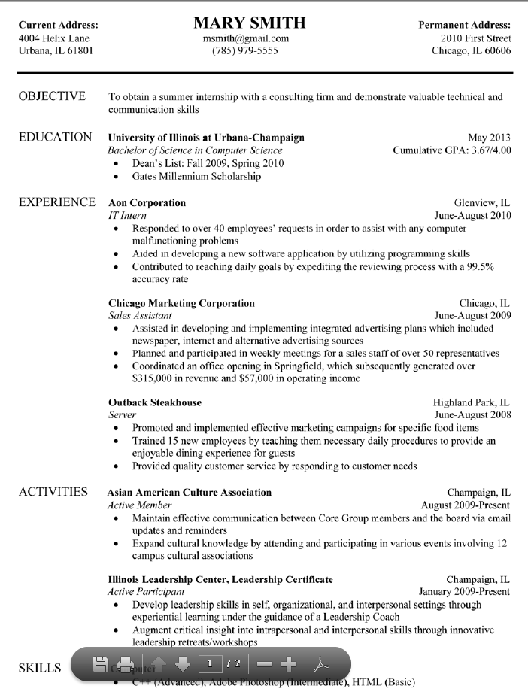
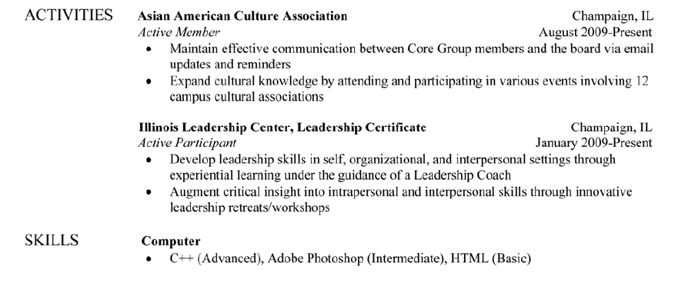

Slide 37
Remember…
Employers spend less than 20 seconds on average looking at a résumé!
Notes:
Therefore, you must take the time to format your résumé and make it stand out amongst all other applicants.
How do you make your resume stand-out amongst the rest?...tailor your resume specifically to the job description.
Don’t make the employers hunt for reasons to give you an interview!

Slide 38
The Cover Letter

Slide 39
Purpose of Cover Letters
“Sales pitch” on how you are the right-fit
Example of your writing abilities
Opportunity to expand upon important experiences
Indicates interest, passion, and knowledge for the organization
Notes:
Explain that often times, students find writing a good cover letter to be the hardest part of applying for any job.
Help rest the audience members’ mind that The Career Center can help students write strong cover letters that exemplify their fit for the position, passion for the work, and excitement for an interview.
Your cover letter can really help show your personality and help tell your story more succinct then a resume.

Slide 40
Cover Letter
One page only
Make sure your cover letter matches your résumé in style, format, AND paper choice
A cover letter is to a specific person – a real name— NOT “to whom it may concern”
Use it to establish a bond with your reader

Slide 41
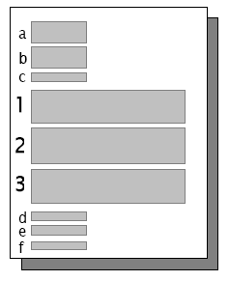
Parts of Cover Letter
Contact Information
Company Address
Salutation
Opening Paragraph
Body Paragraphs
Closing Paragraph
“Sincerely,” “ Regards”
“Sign” your name
Print your name
Notes:
Three parts of the cover letter- opening-body, closing

Slide 42
Cover Letter
Opening Paragraph-Get ATTENTION
State immediately why you are writing (your specific interest in the company or the job)
Specific position/type of work you are looking for
Describe where/how you found the position
Online, I-link, Internal network, etc.
Connect the position to your skills and experiences
Persuade the reader to continue to read the next paragraph
All of the above should be clearly and concisely stated

Slide 43
Cover Letter
Middle Paragraphs- Create DESIRE
Elaborate on 2-3 most relevant and important experiences
Do not rephrase the resume
Illustrate specific skills, responsibility, success, & meeting challenges
Mirror the job description
Reinforce claims and prove skills
Show enthusiasm and passion for the job!
Illustrate what you can do for the employer by discussing HIGHLIGHTS from a few of the following
1. educational background
2. practical work experience
3. significant achievements
4. unique qualifications/interests/personality traits

Slide 44
Cover Letter
Second to Last Paragraph
Refer the reader to your enclosed résumé or job application
Tell the reader exactly what you want (in most cases it is an interview or a follow up meeting)
Telling the employer you will contact him/her on XX date is highly recommended
Restate your contact info, even though it is included on your résumé

Slide 45
Cover Letter
Second to last paragraph, continued
Close the letter with a statement or question that will encourage response.
Examples:
State that you will be in a city where the company is located and will be calling to set up a possible appointment.
Ask if the company will be recruiting in your area and state that you will be calling within a specified time frame to find out.

Slide 46
Cover Letter
Top Left
1) Your contact info; 2) the date; 3) their name, title, organization, and contact info; 4) “Dear Dr./Ms./Mr. [Lastname]:”
Opening Paragraph: Get ATTENTION
Why are you writing this letter?
Middle Paragraphs: Create DESIRE
Why are you perfect for this opportunity? Make a case for yourself using highlights from your résumé, but DO NOT repeat what they can read elsewhere!
2nd to Last Paragraph
Refer to enclosures (e.g., resume) & make call for ACTION
Last Paragraph
Thank the reader for his/her consideration & time
Complimentary closing (“Sincerely”)
Hand-written signature AND type your name
Refer to enclosures

Slide 47
In Summary
Dos:
Do NOTs:
Address the letter to the person who will hire you
Research the company, position, and mission statement
Highlight experiences that are relevant to the position
Error free and on one page
Use cliché phrases like, “I’ve wanted to be a Teacher for as long as I can remember.”
Re-state your resume
Forget about your application (If you don’t hear from the employer within 2 weeks, follow up!)
Notes:
Employers want to see EVIDENCE for why you deserve an interview. If you say, “I’ve wanted to be a Teacher for as long as I can remember” this doesn’t prove you should get an interview. But if someone writes in their cover letter, “Since completing my student-teaching experience at Urbana High School, I have become a stronger communicator and advocate for students.”
Make sure to follow up unless the job posting specifically tells you not to follow up.

